Slide 1
Assignment 03 Helper slides

Slide 2
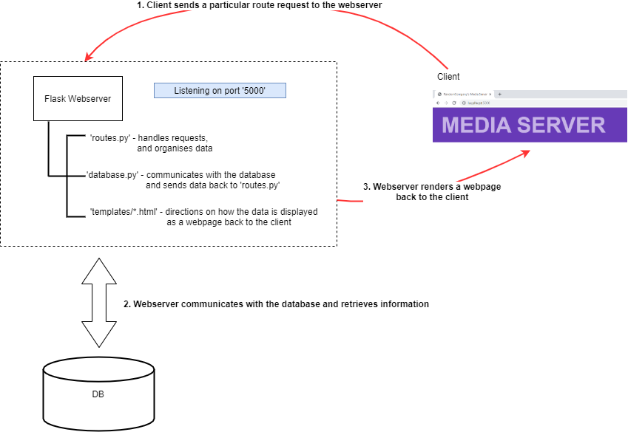
How does the system work?

Slide 3
What do you have to do?
Complete the database handling functions in ‘database.py’ (10 tasks)
Complete the route handing functions in ‘routes.py’ (4 tasks corresponding to 4 of the database handling tasks)
Complete the template displays in ‘templates/*.html’ (4 tasks corresponding to the route handing tasks)
If you complete just the 10 tasks for 1), you can get up to 5/10
If you complete all 18 tasks, you can get up to 8/10
To get the addition 2 marks, you must implement a new functionality, this will involve ALL of the following:
Create a new function in ‘database.py’
Create a new function in ‘routes.py’
Create a new template in ‘templates/*.html’
Add the appropriate menu items in ‘templates/top.html’

Slide 4
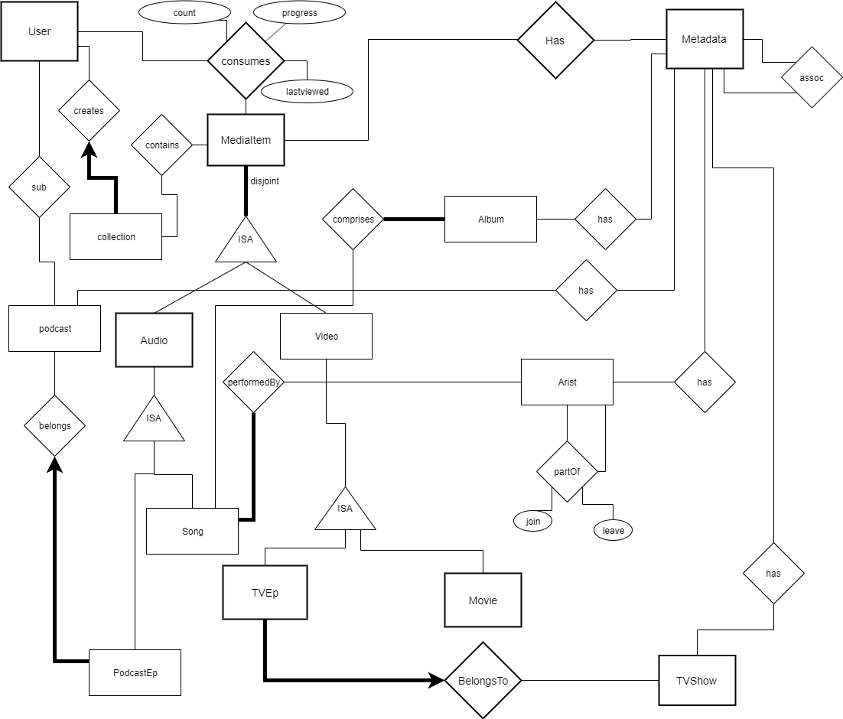

Slide 5
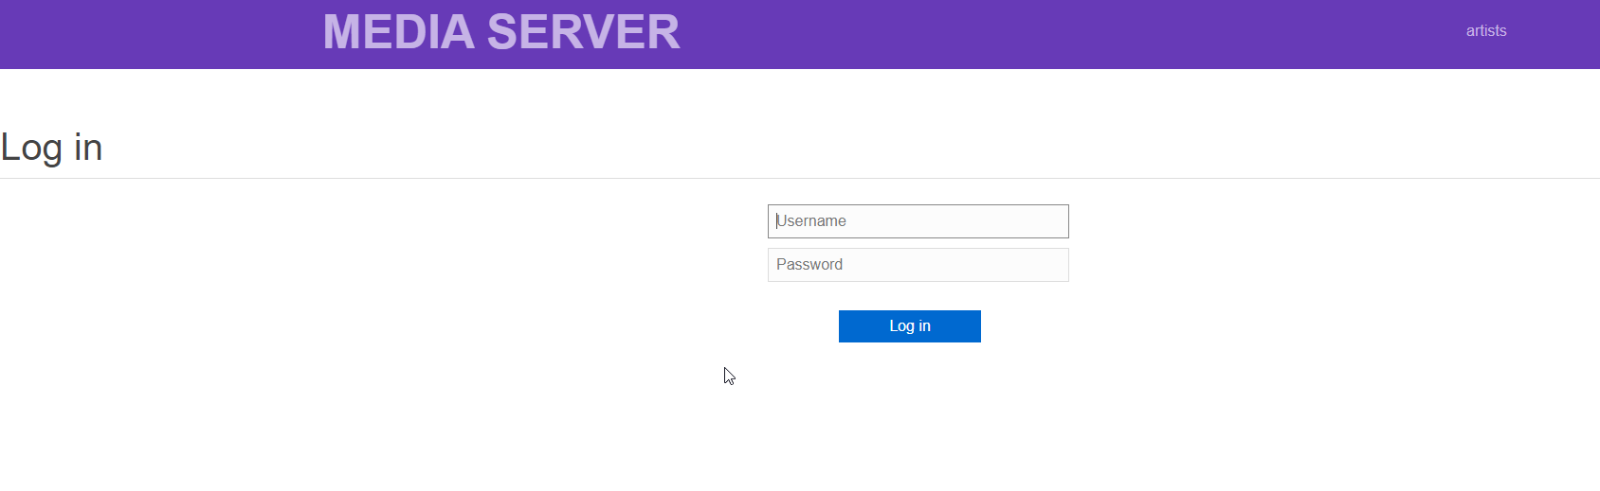
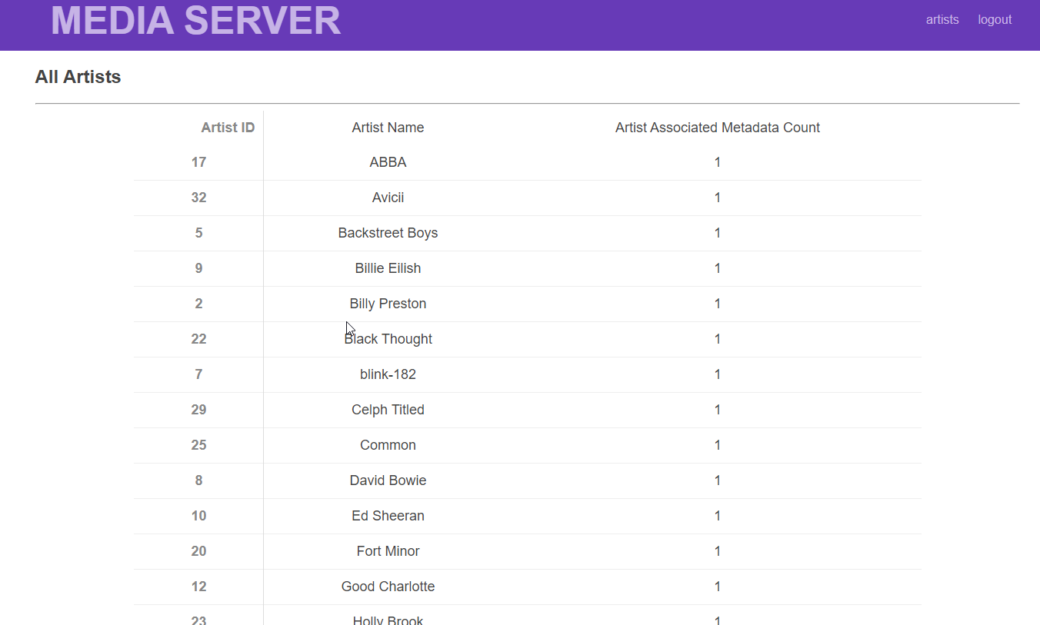
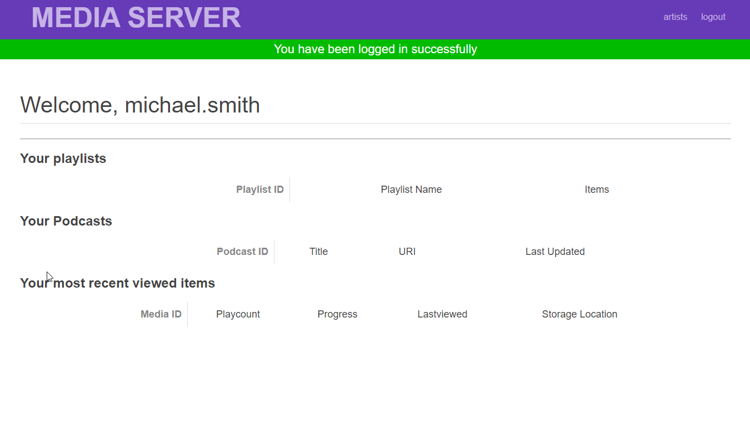
What it looks like

Slide 6
Specific Tasks – Database Tasks in ‘database.py’
Write SQL for getting/checking all relevant details needed to log a user into the system\be
Write SQL for getting all relevant details for a single song
Write SQL for getting Wall relevant details for all TV Shows along with their episode counts
Write SQL for getting all relevant details for a single TV Show and it’s episodes
Write SQL for getting all songs in an Album and their artists
Write SQL for getting all genres in an Album
Write SQL for getting all relevant details for a single podcast episode
Write SQL for getting all relevant details for a Podcast entity
Write SQL for ensuring a proper insert of a new Song
Write SQL for getting all relevant details for searching through all Movies

Slide 7
Specific Tasks – ‘routes.py’ Data handling
Handle data connections for a single podcast episode
Handle data connections for a Podcast entity
Handle data connections for adding a new Song
Handle data connections for searching through all Movies

Slide 8
Specific Tasks – ‘Templates/*.html’ Data Rendering
Handle display/rendering for a single podcast episode
Handle display/rendering for a Podcast entity
Handle display/rendering for adding a new Song
Handle display/rending for searching for a Movie

Slide 9
Recommendations for the extension portion
User Management
Updating password / adding a new user / new contact details
New Search Functionality
Find Related content (particularly using Genres)
Advanced:
Implementing Fuzzy search
Integrating a web-player to actually play content

Slide 10
Where can I find more help?
Canvas Week 08 Tutorial
https://canvas.sydney.edu.au/courses/18176/modules
We have included the solutions – but fair warning, the solutions also used an example of code that was vulnerable to SQL injection. Make sure your code uses parameterised SQL.
Python
https://www.w3schools.com/python/
Flask
https://www.fullstackpython.com/flask.html
Templates: https://www.tutorialspoint.com/flask/flask_templates.htm
PG8000
https://www.programcreek.com/python/example/96338/pg8000.connect
HTML
https://www.w3schools.com/

Slide 11
How to set-up
Download the code base
Unzip into a directory
Update ‘config.ini’ with your unikey and SID
Use a postgres client to open and run ‘mediaserver-schema.sql’
Use a postgres client to open and run ‘mediaserver-sampledata.sql’
On Windows
Edit run.bat to reflect your location for the python executable
On Mac / Linux
Run ./run.command
Open ‘127.0.0.1:5000’ on a browser to access the webserver client side

Slide 12
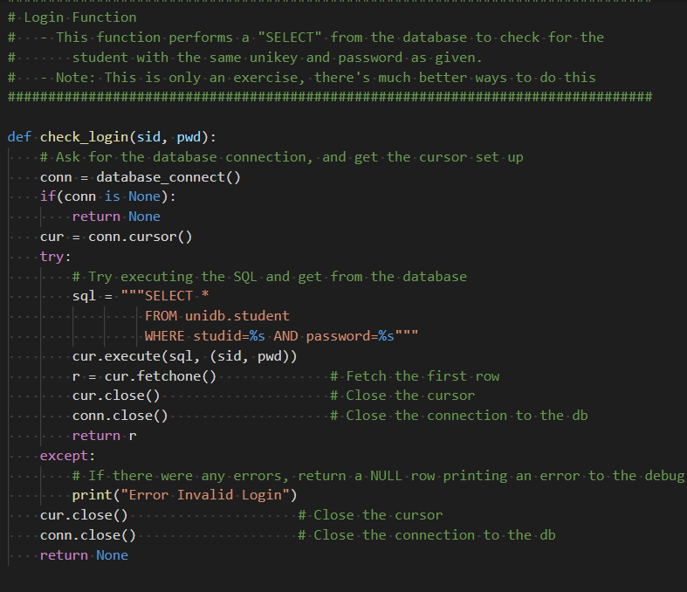
Thanks for the info but how do I even start?!
Task 1 begins with creating a login script
Let’s have a look at the week 08 tutorial.
That seems to be doing everything we need!

Slide 13
Starting …
We just need to change the table and schema names to be correct for the assignment.
So the SQL would be:
```
Select *
FROM mediaserver.UserAccount
Where username=%s
AND
password=%s;```

Slide 14
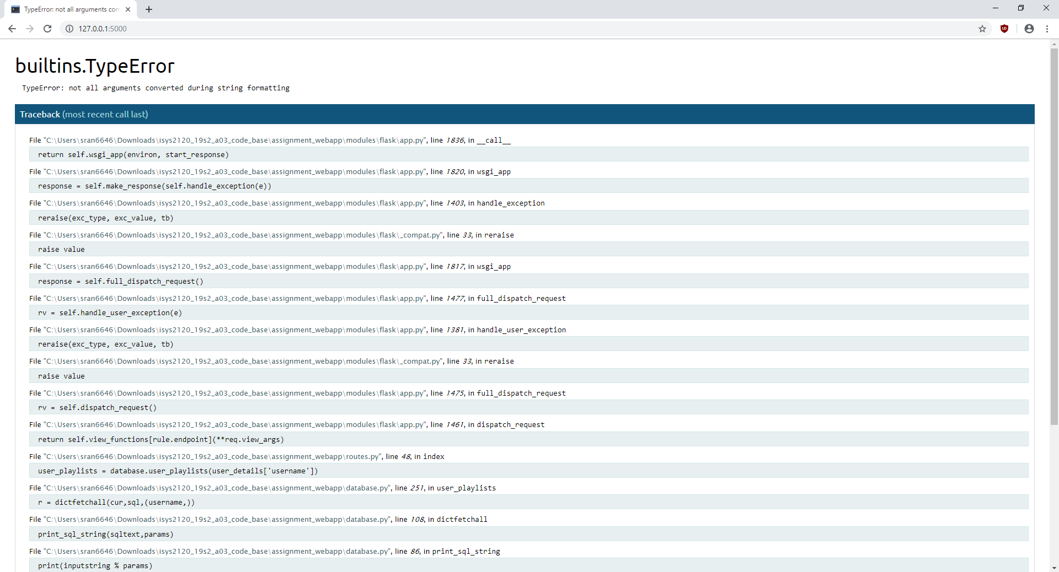
Oh no, we just have errors!
This is a result of the ‘raise’ command at the bottom of your functions in ‘database.py’. It throws the results of the exception to the function above. You can comment out the raise for the other parts of q1 (user_playlists(), user_podcast_subscriptions(), user_in_progress_items() ) to get you started.

Slide 15
… And that’s Logging in Finished!
You can now log in.
Have a look at some sample data to find some user names.
Try the user:
michael.smith
cbHwm2VEL6

Slide 16
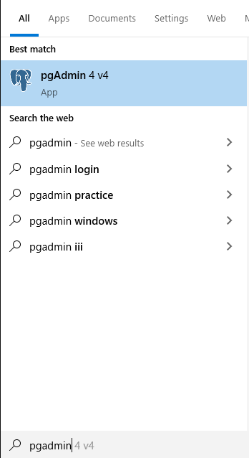
1. Connecting to Postgres using PgAdmin 4
If pgAdmin 4 is all that is available, you can use that too. However if you are installing yourself, I recommend pgadmin III.

Slide 17
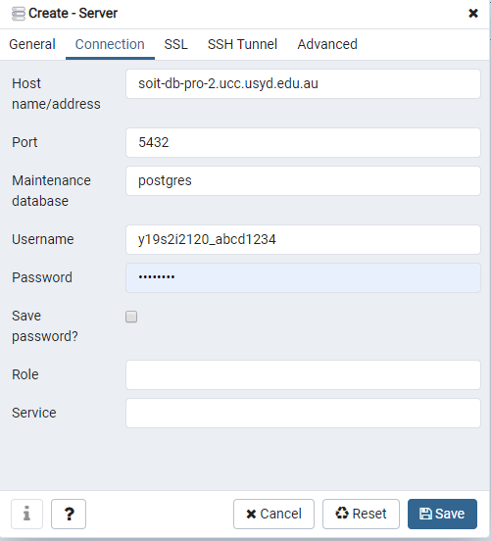
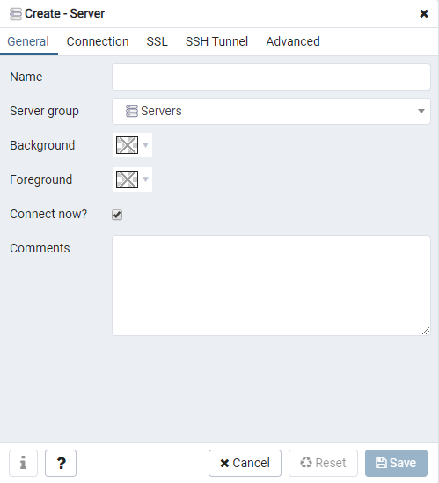
1. Connecting to Postgres using PgAdmin 4
Your first screen will just ask for the name/label. You must click on the connection tab to fill in the remainder of the details
Fill out the New Server details. You only need to add these values:
Name
Host
Username – replace abcd1234 with your unikey
Password – Use your 9 digit student ID
Then click ‘Save’

Slide 18
1. Connecting to Postgres using PgAdmin 4
Connection Settings:
Connection Name: Anything you want, try ‘a03’
Hostname: soit-db-pro-2.ucc.usyd.edu.au
Username: y19s2i2120_<your_unikey>
E.g. if your unikey was abcd1234, your username would be: y19s2i2120_abcd1234
Password: <your 9 digit SID>
E.g If your SID was 499100100, your password would be: 499100100

Slide 19
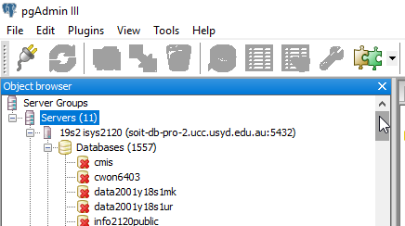
1. Connecting to Postgres using PgAdmin III
You should see a connection under servers for ‘19s2 isys2120’ in your connections tab.
As you can see, there are many databases, you will need to scroll down until you find the database that matches your unikey in the format: ‘y19s2i2120_abcd1234

Slide 20
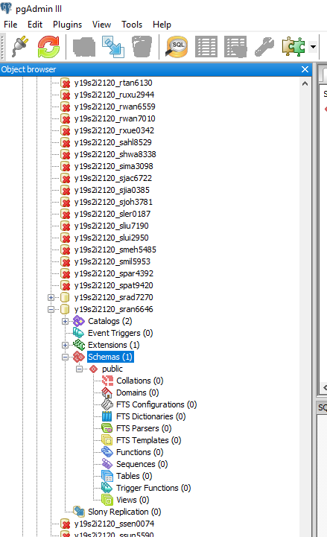
1. Connecting to Postgres using PgAdmin III/4
Once you have found your particular database, you can expand all the items and view the structure of the database.
In postgres, tables are also grouped into schemas. Right now we only have the ‘public’ schema.
However we want to load our assignment 03 schema into a new server

Slide 21
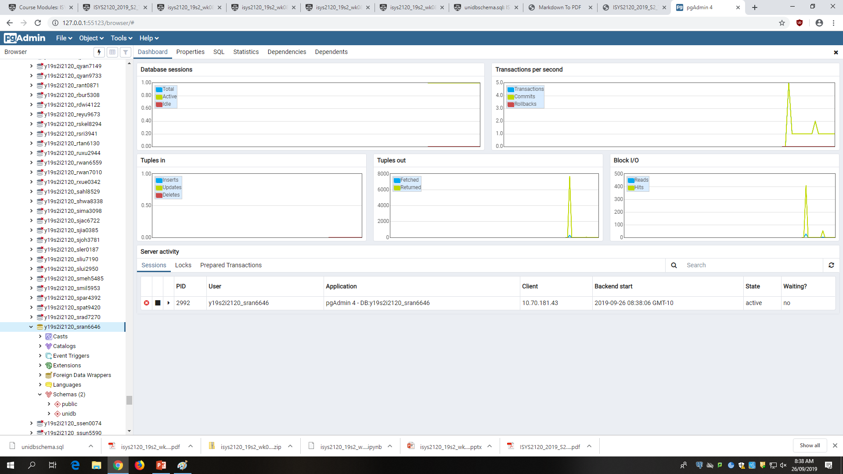
1. Running queries using PgAdmin 4
Scroll down and select your database that corresponds to your login
Click on the ‘lightning’ icon to launch the query tool

Slide 22
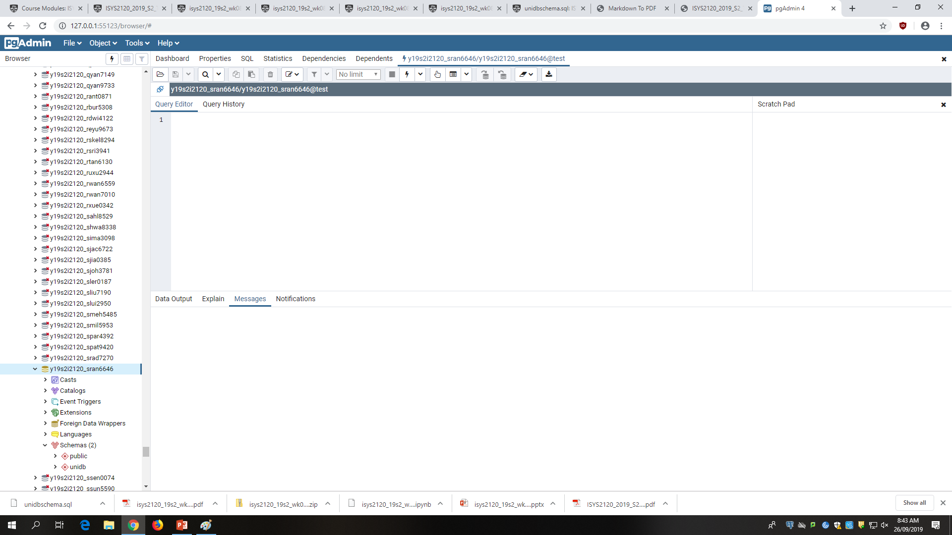
1. Running Queries – Pg Admin4
Query Window
Output Window

Slide 23
Files to Load
First Load ‘mediaserver_schema.sql’
After running that, load ‘mediaserver_sampledata.sql’

Slide 24
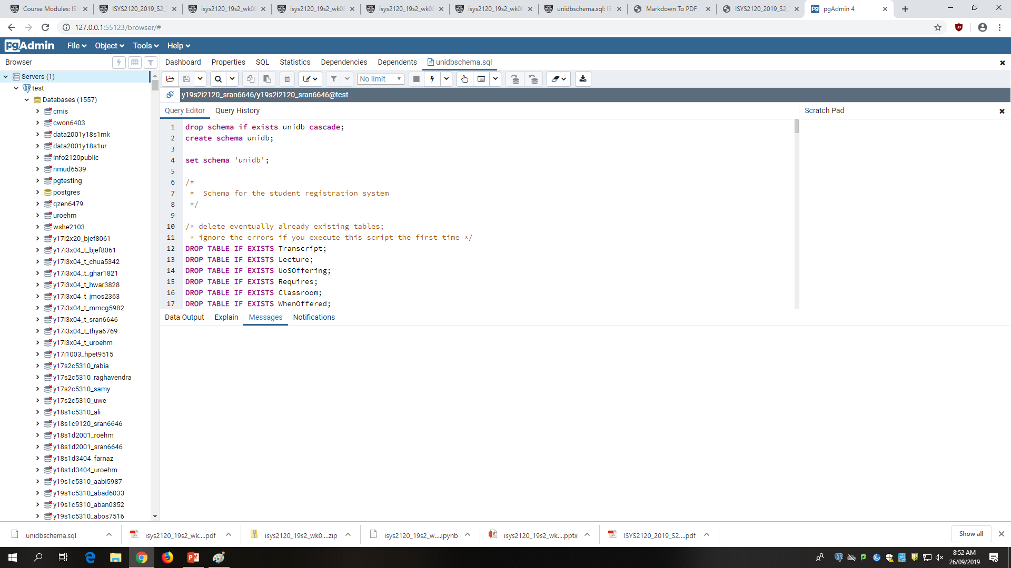
1. Running Queries – pgAdmin4
Once loaded, you can just run the file by pressing the ‘lightning’ icon

